Slide 1


Interactive Truth Table Generator for propositional Logic
By: Asmin Kandel
CS245-01

Slide 2
INTRODUCTION
Propositional logic is a key topic in Discrete Structures
Truth tables show all possible combinations of variables
Manual truth tables are difficult for many variables
Errors are common for beginners
This project automates the process

Slide 3
Problem Statement
Create a program to evaluate logical expressions automatically
Input: Variables like p, q, r and operators (AND, OR, NOT, IMPLIES)]
Output: Complete truth table and classification
Reduce manual errors and save time

Slide 4
Objectives
Allow user to type any logical expression
Tokenize the expression
Convert to Reverse Polish Notation (RPN)
Generate all truth assignments using sets and Cartesian products
Evaluate each combination of variables
Print truth table and classify expression

Slide 5
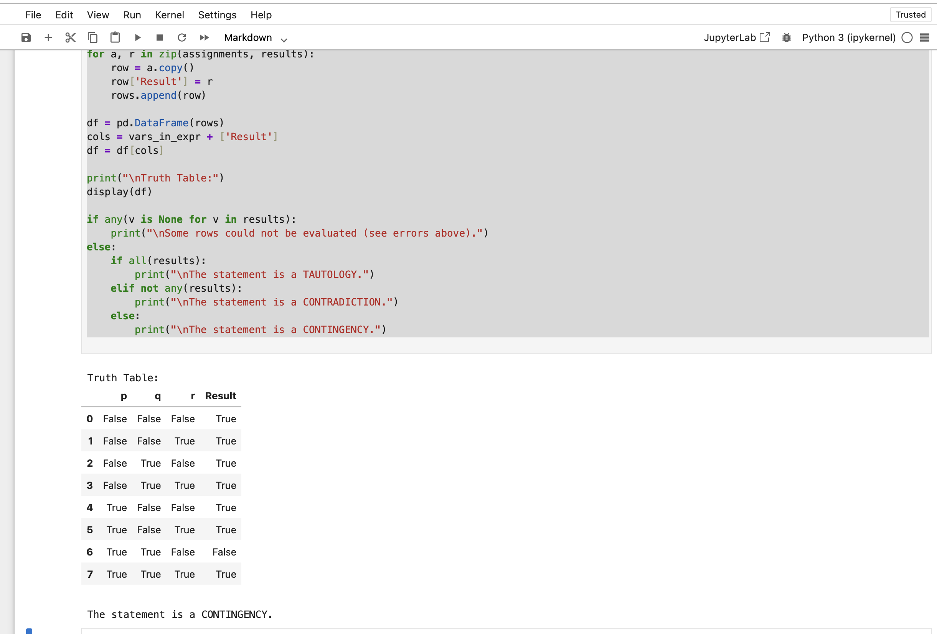
System Overview

Slide 6
Discrete Structure concepts
Sets: store variables, generate all combinations
Functions: logical operators as Boolean functions
Sequences/Stacks: evaluate expressions in RPN
Logic: AND, OR, NOT, IMPLIES and truth table definitions

Slide 7
Why Tokenizer + RPN?
Python cannot directly understand expressions like p AND q
Tokenizer separates variables, operators, parentheses
RPN handles operator precedence easily
Eliminates parentheses complexity
Common technique in calculators and compilers
Ensures correct evaluation of complex expressions

Slide 8
System Components
Input Module: Accepts logical expressions
Tokenizer: Converts expression into tokens
RPN Converter: Converts infix to postfix expression
Variable Extraction: Finds all unique variables
Truth Assignment Generator: Creates all combinations
Evaluation Engine: Uses stack to evaluate RPN
Output Module: Builds truth table and classifies expression

Slide 9
Conclusion and Future Work
Successfully built an Interactive Truth Table Generator
Automatically generates truth tables and classifies expressions
Shows practical use of Discrete Structures concepts
Reliable and easy to use
Support multi-letter variables
Add more logical operators
Make a simple GUI
Enhance error messages for invalid input data.

Slide 10

Thank you

